Slide 1
Linear Regression
Deepak Kumar (Data Scientist, BT&E)
Anusha Pai (Data Scientist, Boeing AI)

Slide 2
What is Machine Learning?
• Arthur Samuel (1959). Machine Learning: Field of study that gives computers the ability to learn without being explicitly programmed.
There are two types of machine learning:
Supervised Learning
Unsupervised Learning

Slide 3
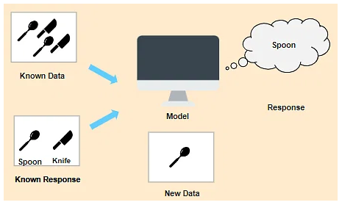
What is Supervised Machine Learning?
In Supervised Learning, the machine learns under supervision. It contains a model that is able to predict with the help of a labeled dataset. A labeled dataset is one where you already know the target answer.
Supervised learning can be further divided into two types:
Classification
Regression

Slide 4
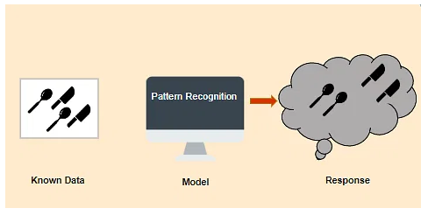
What is Unsupervised Machine Learning?
In Unsupervised Learning, the machine uses unlabeled data and learns on itself without any supervision. The machine tries to find a pattern in the unlabeled data and gives a response.

Slide 5
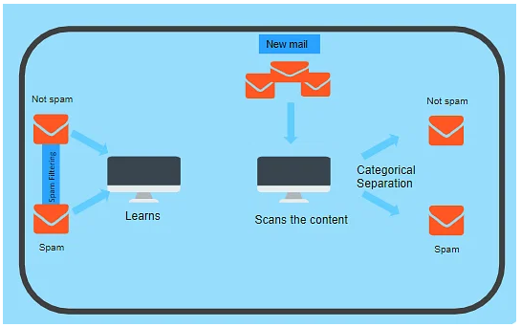
What is Classification?
Classification is used when the output variable is categorical i.e. with 2 or more classes. For example, yes or no, male or female, true or false, etc.

Slide 6
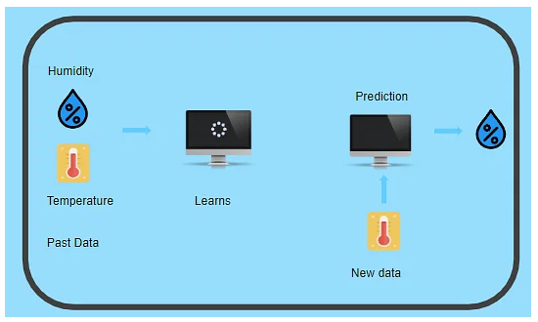
What is Regression?
Regression is used when the output variable is a real or continuous value. In this case, there is a relationship between two or more variables i.e., a change in one variable is associated with a change in the other variable. For example, salary based on work experience or weight based on height, etc.

Slide 7
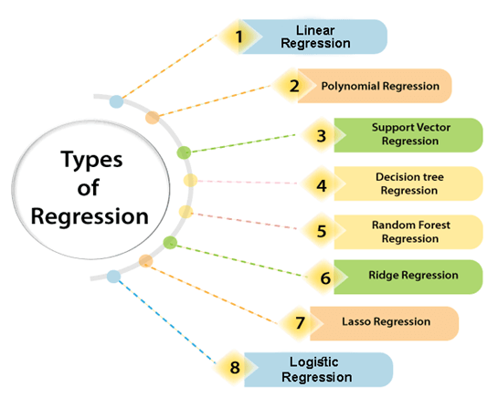
There are various types of regressions which are used in data science and machine learning.
Each type has its own importance on different scenarios, but at the core, all the regression methods analyze the effect of the independent variable on dependent variables.

Slide 8
What is Linear Regression?
Linear regression is a type of statistical analysis used to predict the relationship between two variables.
It assumes a linear relationship between the independent variable and the dependent variable and aims to find the best-fitting line that describes the relationship.
The line is determined by minimizing the sum of the squared differences between the predicted values and the actual values.

Slide 9
Equation of a straight line
y = mx + c
y
y = dependent variable
x = independent variable
m = slope
c = intercept
m
x
c

Slide 10

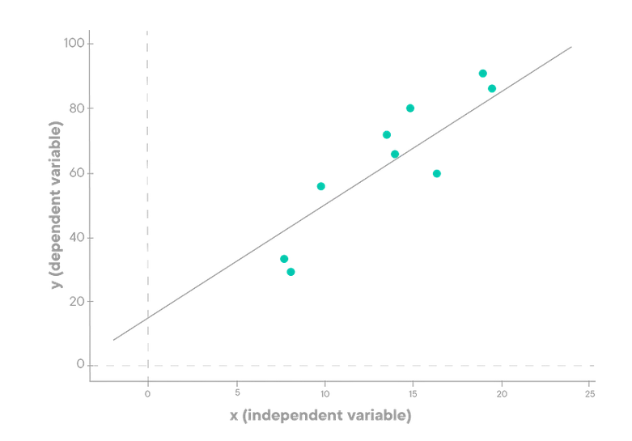
Simple Linear Regression
Y the dependent variable
X the independent variable
β0 the intercept
β1 the slope (the expected increase in Y when X increases by one unit)
ϵ the residuals (the error term of mean 0 which describes the variations of Y not captured by the model, also referred as the noise)

Slide 11
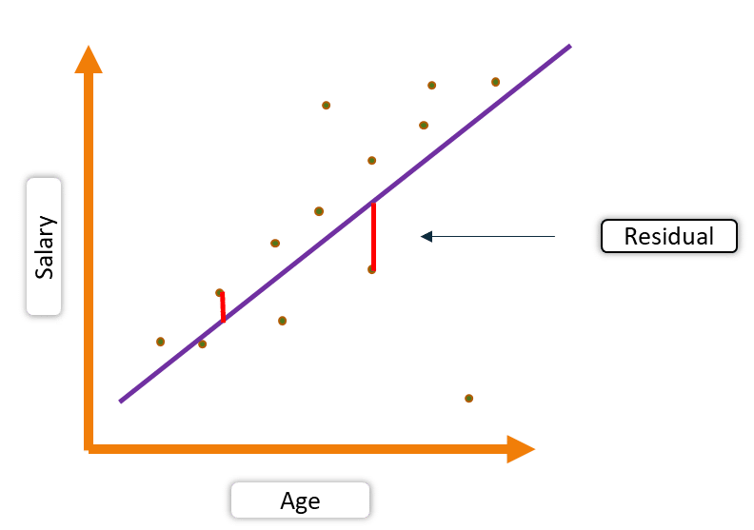
Simple Linear Regression
For each point, the difference between the predicted point and the actual observation is the residual

Slide 12
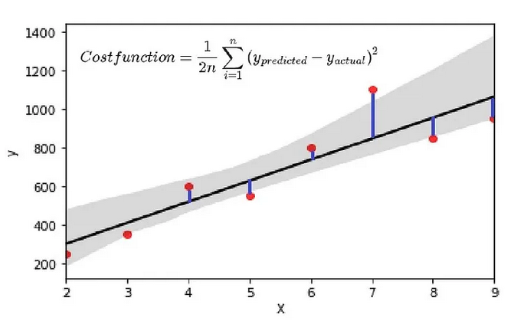
Residual Sum of Squares (RSS)
To find out the best-fit line, we use residual sum of squares (RSS).
In RSS, we take the square of the residuals and sum them up.
Mean of residual sum of squares (RSS) will now be our cost function
Minimize the cost function to find the slope and intercept of the best fit line
This method of finding the line of best fit is called method of least squares

Slide 13
Gradient descent
Source: https://alykhantejani.github.io/images/gradient_descent_line_graph.gif

Slide 14
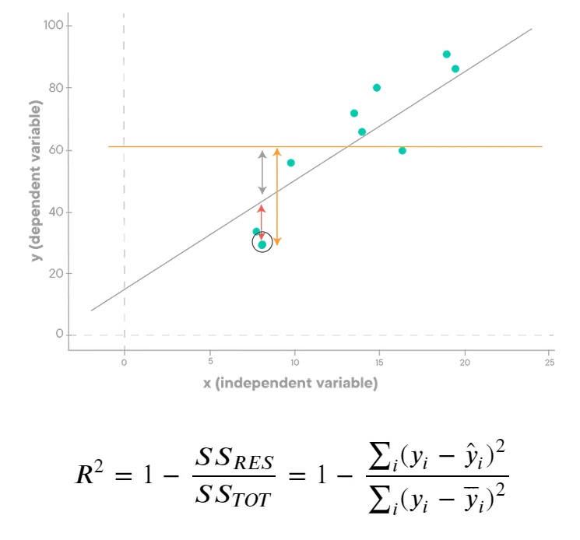
Coefficient of Determination (R²)
Is our fitted regression line better than our baseline model?
Residual Sum of Squared Errors (RSS) is sum of all squared difference between actual Y and predicted Y. (red arrow)
Total Sum of Squared Error (TSS) is the sum of all squared difference between Y and mean of Y. (vertical orange arrow)
An R-squared of zero means our regression line explains none of the variability of the data
An R-squared of 1 would mean our model explains the entire variability of the data.
regressions explaining the entire variability are rare. What we usually observe are values ranging from 0.2 to 0.9

Slide 15

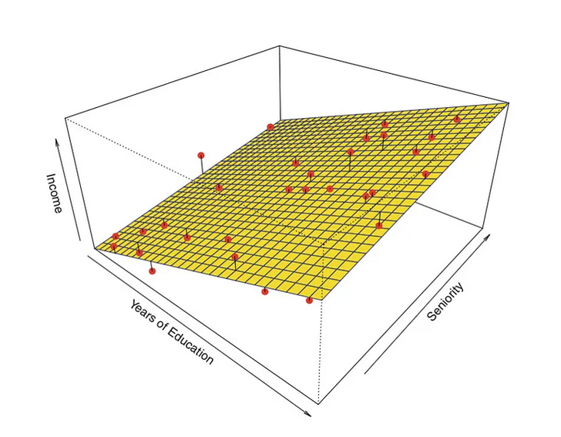
Multiple Linear Regression
It is similar to the equation of simple linear regression, except that there is more than one independent variables (X₁,X₂,…,X_{p}).
Estimation of the parameters β₀,…,β_{p} by the method of least squares is based on the same principle as that of simple linear regression, but applied to p dimensions.
It is thus no longer a question of finding the best line (the one which passes closest to the pairs of points (y_{i},x_{i})), but finding the p-dimensional plane which passes closest to the coordinate points (y_{i},x_{i1},…,x_{ip}).

Slide 16
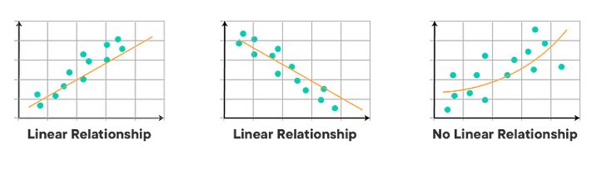
Assumptions of linear regression
Linearity
The relationship between the dependent and independent variables is linear.

Slide 17
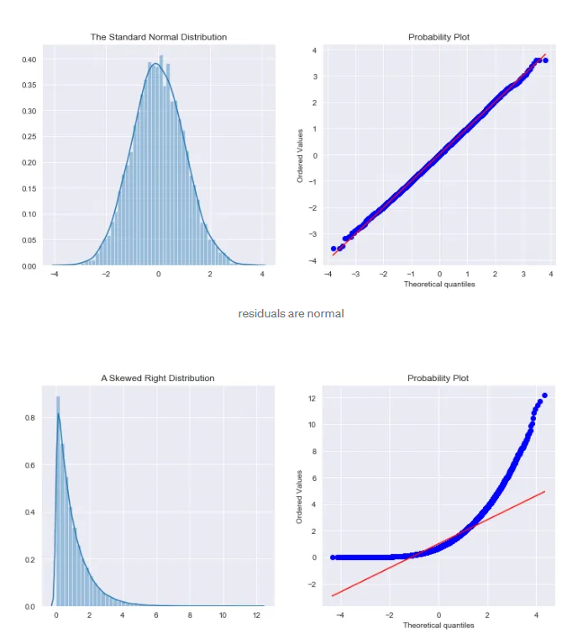
Assumptions of linear regression
Normality
The normality assumption states that the model residuals should follow a normal distribution.

Slide 18
Assumptions of linear regression
Homoscedasticity
Y
Y
The variance of the errors is constant across all levels of the predictor variable.
x
x
residuals
x
x
residuals
Non-constant variance
Constant variance
Heteroscedasticity
Homoscedasticity

Slide 19
Assumptions of linear regression
Independence
The observations are independent of each other.
Not Independent
✓
Independent
residuals
X
residuals
X
residuals
X

Slide 20



Applications of linear regression
Linear regression can be applied in a wide range of fields, from finance to healthcare to marketing. We'll explore the various applications of linear regression and how it can be used to solve complex problems.
Marketing Analytics
Finance
Medical Research
Use regression to determine how various marketing efforts impact product sales.
Use regression to predict future stock prices and analyze investments.
Use regression to determine how lifestyle choices impact health outcomes.

Slide 21


Slide 22
Appendix

Slide 23
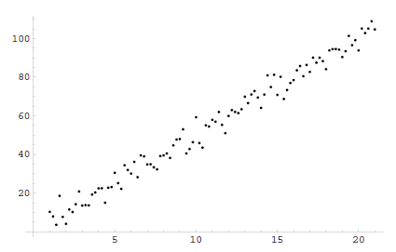


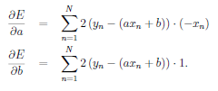


Method of Least Squares
The method of least squares is the procedure to find the best fit curve to a random set of points.
Variance for this dataset is
y
Error =
The goal is to find the values of a and b that will minimize the error.
x
We want to find the best fit line showing relation between x and y

Slide 24

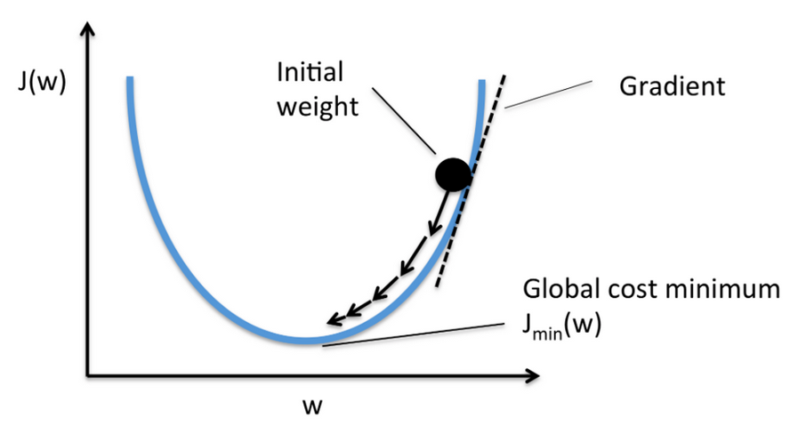
The method of Least Squares – Gradient Descent
Gradient Descent is a generalized method for minimizing a function.
The method essentially changes the values of theta bit by bit until it finds the minimum.
Bringing it all together, we get Linear Regression

Slide 25
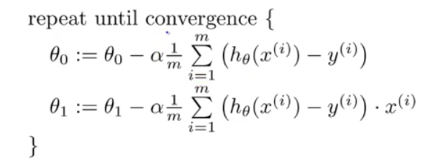


Find theta (Ө)such that it minimizes the cost function

Slide 26


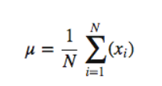
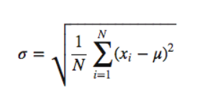
Feature Scaling
Why is Feature Scaling needed?
Values of different numerical features to fall within a similar range like each other
Prevents models from getting biased toward a specific range of values.
Faster convergence
Min-max scaling
Min-max scaling normalizes the data
Normalizing refers to the rescaling of the features to a range of [0, 1]
Standard Scaler
Standardizing, transform your data such that its distribution will have a mean value 0 and standard deviation of 1

Slide 27


